Slide 1

Machine Learning based Diagnostic System for Sleep Disorder
PROJECT BATCH:B2
PROJECT MEMBERS:
R.Premonvitha Sai (20-4244)
Y.P.V.Bhargavi (20-4262)
A.Maanvitha (20-4203)
K.N.V.Sahithi (20-4223)
PROJECT GUIDE:
Mr. Dr. M R K Krishna Rao Professor
Department of CSE(AI & ML)
GVPCEW
Department of Computer Science and Engineering(AI&ML)
GAYATRI VIDYA PARISHAD COLLEGE OF ENGINEERING FOR WOMEN
[Approved by AICTE NEW DELHI, Affiliated to JNTUK Kakinada]
[Accredited by National Board of Accreditation(NBA) for B.Tech. CSE, ECE & IT – valid from 2019-22 and 2022-25]
[Accredited by National Assessment and Accreditation Council (NAAC) with A Grade – valid from 2022-27]
Kommadi, Madhurawada, Visakhapatnam – 530048
Academic Batch : 2020 – 2024

Slide 2
ABSTRACT
This project leverages machine learning supervised models to address the pervasive global issue of sleep disorders, affecting 10-30% of the population. Utilizing algorithms such as Logistic Regression (LR), Random Forest (RF), and Support Vector Classifier (SVC), existing predictive modeling system demonstrates impressive accuracy in predicting risks for specific disorders, including Obstructive Sleep Apnea (OSA), Central Obstructive Mixed Sleep Apnea (COMISA), and insomnia. Evaluation metrics, such as the Area Under the Receiver Operating Characteristic (AUROC), showcase the effectiveness of these models in providing accurate predictions. This project employs a supervised machine learning approach to diagnose prevalent sleep disorder . Utilizing robust algorithms such as Support Vector Classifier (SVC), GaussianNB and Logistic Regression, our predictive modeling system showcases superior diagnostic capabilities. The incorporation of ensemble techniques, including ExtraTreeClassifier enhances the overall predictive accuracy. Evaluation metrics, such as ROC-AUC curves and F1 score, demonstrate the effectiveness of the models in diagnosing specific disorders like Insomnia, Sleep Apnea.

Slide 3
BASE PAPER DETAILS
Title: Predicting the Risk of Sleep Disorders Using a Machine Learning–Based Simple Questionnaire: Development and Validation Study,
Authors: Ha S, Choi SJ, Lee S, Wijaya RH, Kim JH, Joo EY, Kim JK
Journal Published: Journal of Medical Internet Research,
Year Published: September, 2023.
Machine Learning models used: XGBoost, Random Forest, Logistic Regression.
Hyperparameter tuning techniques: Bayesian Optimization.

Slide 4
IDENTIFIED BASE PAPER DETAILS
1. Technologies and Development Frameworks:
Programming Languages and Libraries: Utilization of Python (version 3.8) with Scikit-Learn and XGBoost packages for machine learning model development, and Bayesian Optimization package for hyperparameter tuning.
Web Platform: Development of a user-friendly website using React JS for the frontend and Django for the backend, facilitating easy access to sleep disorder risk assessment.
2. Machine Learning Models:
Primary Model Used: Employment of XGBoost (Extreme Gradient Boosting) for its efficiency in handling missing values and its robustness in prediction accuracy across various datasets.
Model Comparison: Logistic regression, random forest, and support vector classifiers were tested for performance comparison, with XGBoost demonstrating superior accuracy in predicting sleep disorders.

Slide 5
3. Model Output and Accessibility
Predictive Outputs: The model predicts the risk of obstructive sleep apnea (OSA), comorbid insomnia and sleep apnea (COMISA), and insomnia based on responses to a simplified questionnaire.
Public Access and Utility: A publicly accessible website was created, offering an easy-to-use interface for users to assess their risk of having OSA, COMISA, and insomnia, enhancing public awareness and potential early diagnosis.
4. Accuracy Metrics and Model Validation
AUROC as Primary Metric: High accuracy demonstrated by an AUROC greater than 0.897 for all three sleep disorders, indicating the model’s capability to distinguish between positive and negative cases effectively.
AUPRC for Imbalanced Data: Application of AUPRC to account for data imbalance, especially in the prediction of COMISA and insomnia, with the model showing substantial predictive power despite the challenges of imbalanced datasets.

Slide 6
LITERATURE SURVEY
S.NO | Title and Authors | Year and published journal | Dataset used | Approach | Outcome | Limitations
1. | Predicting the Risk of Sleep Disorders Using a Machine Learning–Based Simple Questionnaire: Development and Validation Study, Ha S, Choi SJ, Lee S, Wijaya RH, Kim JH, Joo EY, Kim JK | Journal of Medical Internet Research, September, 2023. | The data from 2 medical centers Samsung Medical Center and Ewha Womans University Medical Center Seoul Hospital). | Logistic regression (LR), random forest (RF), and support vector classifier,XGBoost. | SLEEPS has high accuracy in predicting the risk of OSA (AUROC=0.897), COMISA (AUROC=0.947), and insomnia (AUROC=0.922) | The primary limitation of the research is the exclusion of mild obstructive sleep apnea (OSA) cases in the model, as it used a cutoff AHI of 15 per hour for OSA.
2. | Application of various machine learning techniques to predict obstructive sleep apnea syndrome severity. Han, H., Oh, J. | Scientific Journals, April,2023. | NYX Dataset. | hierarchical agglomerative clustering, K-means, bisecting K-means, Gaussian mixture model) and gradient boost-based classification models | In this study, we used diverse machine learning techniques to predict the severity of OSAS with only simple information | The data collected from a single sleep clinic and the retrospective nature of the analysis.

Slide 7
S.NO | Title and Authors | Year and published journal | Dataset used | Approach | Outcome | Limitations
3. | Brief digital sleep questionnaire powered by machine learning prediction models identifies common sleep disorders. Schwartz, Alan R., Mairav Cohen-Zion, Luu V. Pham, Amit Gal, Mudiaga Sowho, Francis P. Sgambati, Tracy Klopfer et al. " | Elsevier, July,2020. | DSQ dataset | ElasticNet models, a type of regularized linear regression model, were utilized in the research for predicting common sleep disturbances | The predictive models showed good to excellent diagnostic performance, accurately classifying sleep disturbances with high sensitivity and acceptable specificity across several sleep disorders. | small sample size and the potential for overfitting are noted
4. | A classification of sleep disorders with optimal features using machine learning techniques. Wongsirichot, T. and Hanskunatai, A. | Journal of Health Research, May,2017. | PSG Dataset. | k-Means Clustering, KNN, (SVM), and Multi-Layer Perceptron (MLP) algorithms to classify sleep disorders based on physiological signal features. | The research achieved a sleep disorder classification model using optimal features (PULSE, SAO2, CANR, CHEST) and introduced an optimized k-Nearest Neighbors (opf-kNN) algorithm, | Limitations include a focus on subjects with positive OSA symptoms, potential bias.

Slide 8
S.NO | Title and Authors | Year and published journal | Dataset used | Approach | Outcome | Limitations
5. | Sleep Expert—an intelligent medical decision support system for sleep disorders. Korpinen, L., and H. Frey. | International Journal of Medical Informatics, July,2009. | Academic databases, libraries | A knowledge-based approach, utilizing the International Classification of Sleep Disorders and Knowledge pro (Windows) to develop an interactive decision support system. | Diagnosing and classifying sleep disorders based on the International Classification of Sleep Disorders. | Handling borderline diagnoses, dependency on classification's consideration of differential diagnosis, and ongoing system evaluation and development needs.
6. | “A Machine-Learning Approach for Accurate Sleep Apnea Detection Using Electronic Health Data” Ashir Javeed, Johan Sanmartin Berglund, Ana Luiza Dallora, Muhammad Asim Saleem, Peter Anderberg | International Journal of Computational Intelligence Systems, 5 October 2023. | The collected dataset for this study consists of 75 features with a total sample size of 10765. | Presented a ML model that can predict sleep apnea based on EHR, conventional LSTM and BiLSTM models | BiLSTM achieving the highest test accuracy of 95.12% compared with conventional LSTM models of 94.56%. | Instead of using a single modality, a multimodal dataset should be used for the prediction of sleep apnea.

Slide 9
S.NO | Title and Authors | Year and published journal | Dataset used | Approach | Outcome | Limitations
7. | “A review of automated sleep disorder detection” Shuting Xua, Oliver Faustb, Seoni Silviac, Subrata Chakrabortye, Prabal Datta Baruaa, Filippo Molinaric, U. Rajendra Acharya | Cogninet Brain Team, Sydney, NSW 2010, Australia. | MIT PhysioNet Apnea datasets. | AI-based detection methods. Both ML and Deep Learning (DL) methods were used for sleep disorder detection. | Categorisation of the sleep disorders. | A data-related limitation arises from the selection process, leading to training and testing data for AI algorithms.
8. | “Sleep APNEA Analysis by Machine Learning Algorithms Using ECG Signals” V.Ankitha,P.Manimegalai, Dr.P.Subha Hency Jose, Raji.P | Journal of Physics: Conference Series 1937 (2021) . | Dataset constructed by Features Extracted from the ECG signals. | Machine Learning Algorithm, Support vector machine (SVM), k- Nearest Neighbour algorithm (k-NN), Random forest algorithm. | With accuracy of 82.5% , 97% , and 89% , Random Forest, Support Vector Machine, and kNN are the most accurate. | Some of the features derived from ECG and HRV signals were common, some typical expressions were used in some areas.

Slide 10
S.NO | Title and Authors | Year and published journal | Dataset used | Approach | Outcome | Limitations
9. | “Detection and Classification of Obstructive Sleep Apnea Disorders: A Comparative Analysis of Various Deep Machine Learning Classifiers” Madhavi Kemidi, Venkat Krishna Chantigari. | published by IIETA, 28 November 2022. | Dataset constructed from papers that were published from the year 2000 through 2021. | ML, DL methods and algorithms, various deep learning techniques and Deep Neural Networks. | CNN and LSTM classifier are best suited for Sleep Apnea with improved performance accuracy. | Studies are transformed into a rule-based system and presented for the use of attending physicians.
10. | “Simultaneous Sleep Stage and Sleep Disorder Detection from Multimodal Sensors Using Deep Learning” Yi-Hsuan Cheng, Margaret Lech, Richardt Howard Wilkinson. | Sensors for Physiological Monitoring and Digital Health, 28 February 2023. | PhysioNet CAP Sleep database from the Sleep Disorders Center of the Ospedale Maggiore of Parma, Italy. | Classical Decision-Making Methods, Decision-Making Neural Network (NN), CNN Classifiers. | The system was validated using the PhysioNet CAP Sleep database and achieved 94.34% classification accuracy for sleep stage recognition and 99.09% for sleep disorder recognition. | The accuracy rate in the classification process decreases as the number of classes increases.

Slide 11
S.NO | Title and Authors | Year and published journal | Dataset used | Approach | Outcome | Limitations
11. | "Obstructive Sleep Apnea: A Prediction Model Using Supervised Machine Learning Method" Zahra Keshavarz, Rita Rezaee, Mahdi Nasiri, and Omid Pournik. | Studies in Health Technology and Informatics journal, 2020 | The dataset was collected at Nemazi Hospital affiliated with Shiraz University of Medical Sciences | Naïve Bayes Logistic Regression, (KNN),(SVM) Random Forest | Adequate power of discrimination, and physicians can use them as a supplementary tool to screen high-risk OSA patients | Retrospective data gathering Limited study population (only patients with stroke)
12. | Sleep Apnea detection using Deep Learning Methodologies Author: Gunjit Jain | Ncirl,2022. | The dataset used in this project is the Apnea-ECG Database | ANN,CNN, Random Forest | Diagnose sleep apnea at home using a smartwatch with the u goal of simplifying the PSG procedure. | Limited ECG Readings in the Database Availability of SpO2 Measurement
13. | Automated Sleep Stage Detection Based on Recurrence Quantification Analysis Using Machine Learning. N. Talebi and A. M. Nasrabadi | Journal of Applied Research and Industrial Engineering, 2022 | The dataset used in this project is extracted from a resource called Sleep-EDF in the Physionet database | RQA ,MLP, CNN,RNN | The maximum accuracy obtained in this project was 85.1% with a Cohen's Kappa coefficient of 0.8214 for balanced data. | Complexity of Calculations Low Execution Speed

Slide 12
S.NO | Title and Authors | Year and published journal | Dataset used | Approach | Outcome | Limitations
14. | A High-Performance Framework for Detecting Sleep Disorders and Apnea Events. Recep Sinan Arslan. | PeerJ Computer Science, 2023 | he dataset includes records of apnea, hypopnea, and normal sleep events for the patients. | ANN,SVM ,KNN ,Random forest, Logistic regression | Identifying sleep disorders and apnea events using a combination of deep learning and machine learning approaches. | Data collection complexity Real-time monitoring limitations Integration challenges with wearable technologies
15. | A Survey on Recent Advances in Machine Learning Based Sleep Apnea Detection Systems Anita Ramachandran , Anupama Karuppiah | Department of Electrical & Electronics Engineering, BITS, Pilani-K K Birla Goa Campus, 2021 | EEG dataset | LSTM approaches were compared with SVM and threshold based approaches. | Normal and apnea epochs were extracted from the IR-UWB data.15 statistical features were derived from these extracted epochs. | non-wearable techniques such as BCG-embedded beds or camera based systems do not have restric_x0002_tions on their size or form factor.

Slide 13
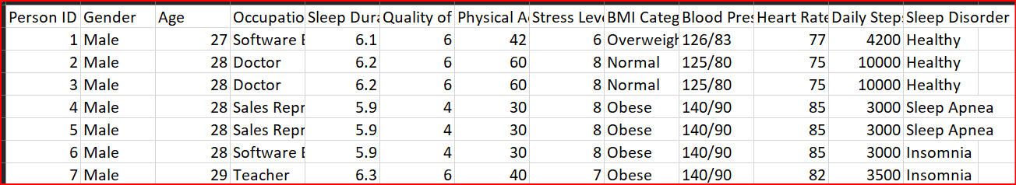
DATA COLLECTION
Dataset Description
a. Type of dataset: Combination of Numerical Data, Categorical Data. b. Sleep Disorders: Insomnia, Sleep Apnea, Healthy.
c. Dataset Size: Dataset size (rows, columns): (374,13)
Sample Dataset

Slide 14
EXISTING SYSTEM
Python and related libraries were employed to create a machine learning model with XGBoost, achieving an AUROC of over 0.897 for predicting sleep disorders.
The model's effectiveness was enhanced through Bayesian optimization, leading to precise hyperparameter selection and improved accuracy scores.
SLEEPS, developed to assess the risk of OSA, COMISA, and insomnia using XGBoost, outperformed other models with high accuracy and AUROC scores.
The web platform built with React JS and Django facilitates access to the model, which consistently delivered high AUROC scores for sleep disorder prediction.
Compared to traditional methods, the XGBoost-based SLEEPS model showed superior accuracy, with AUROC values greater than 0.897 across all predicted sleep disorders.

Slide 15
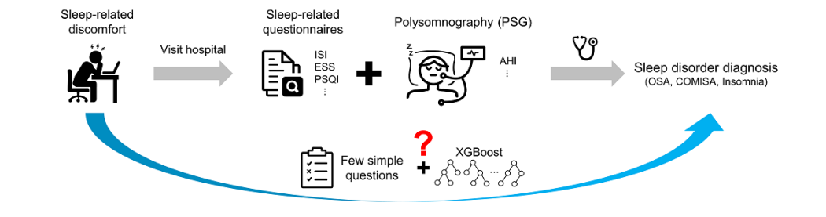
EXISTING SYSTEM

Slide 16
PROPOSED SYSTEM
1. Utilizes various ML Supervised algorithms for sleep disorder prediction and severity assessment.
2. Employs classification and ensemble learning techniques like Logistic Regression, SVC,
ExtraTreeClassifier.
3. The best model is determined by evaluating accuracies, losses, precision, recall, and F1-score across different ML models.
4. The system provides risk level warnings based on the probability of having a sleep disorder.
5. Based on the predicted sleep disorder and the associated risk level, the system offers therapy recommendations to users.

Slide 17
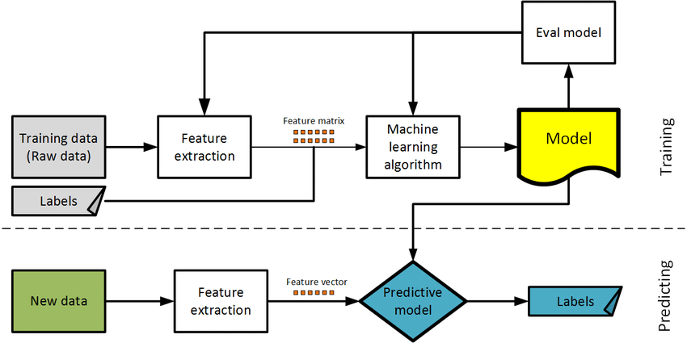
SYSTEM OVERVIEW
Insomnia
Sleep Apnea
Predicting Sleep Disorder
Healthy
Predicting Risk level of Sleep Disorder
High
Predict
output
Moderate
Predicting probability of effecting Sleep Disorder
Suggesting
Self-care Therapy
Supervised Learning Models

Slide 18
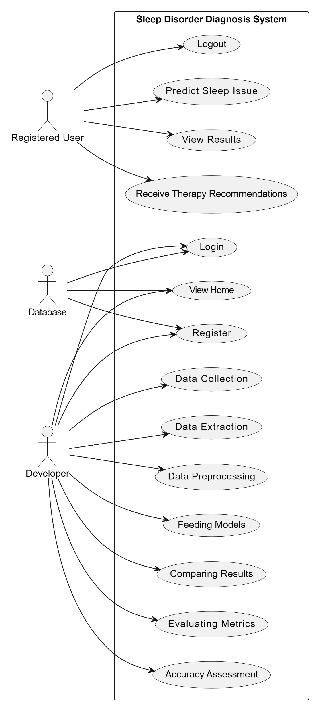
UML Diagrams
1. Use Case Diagram

Slide 19
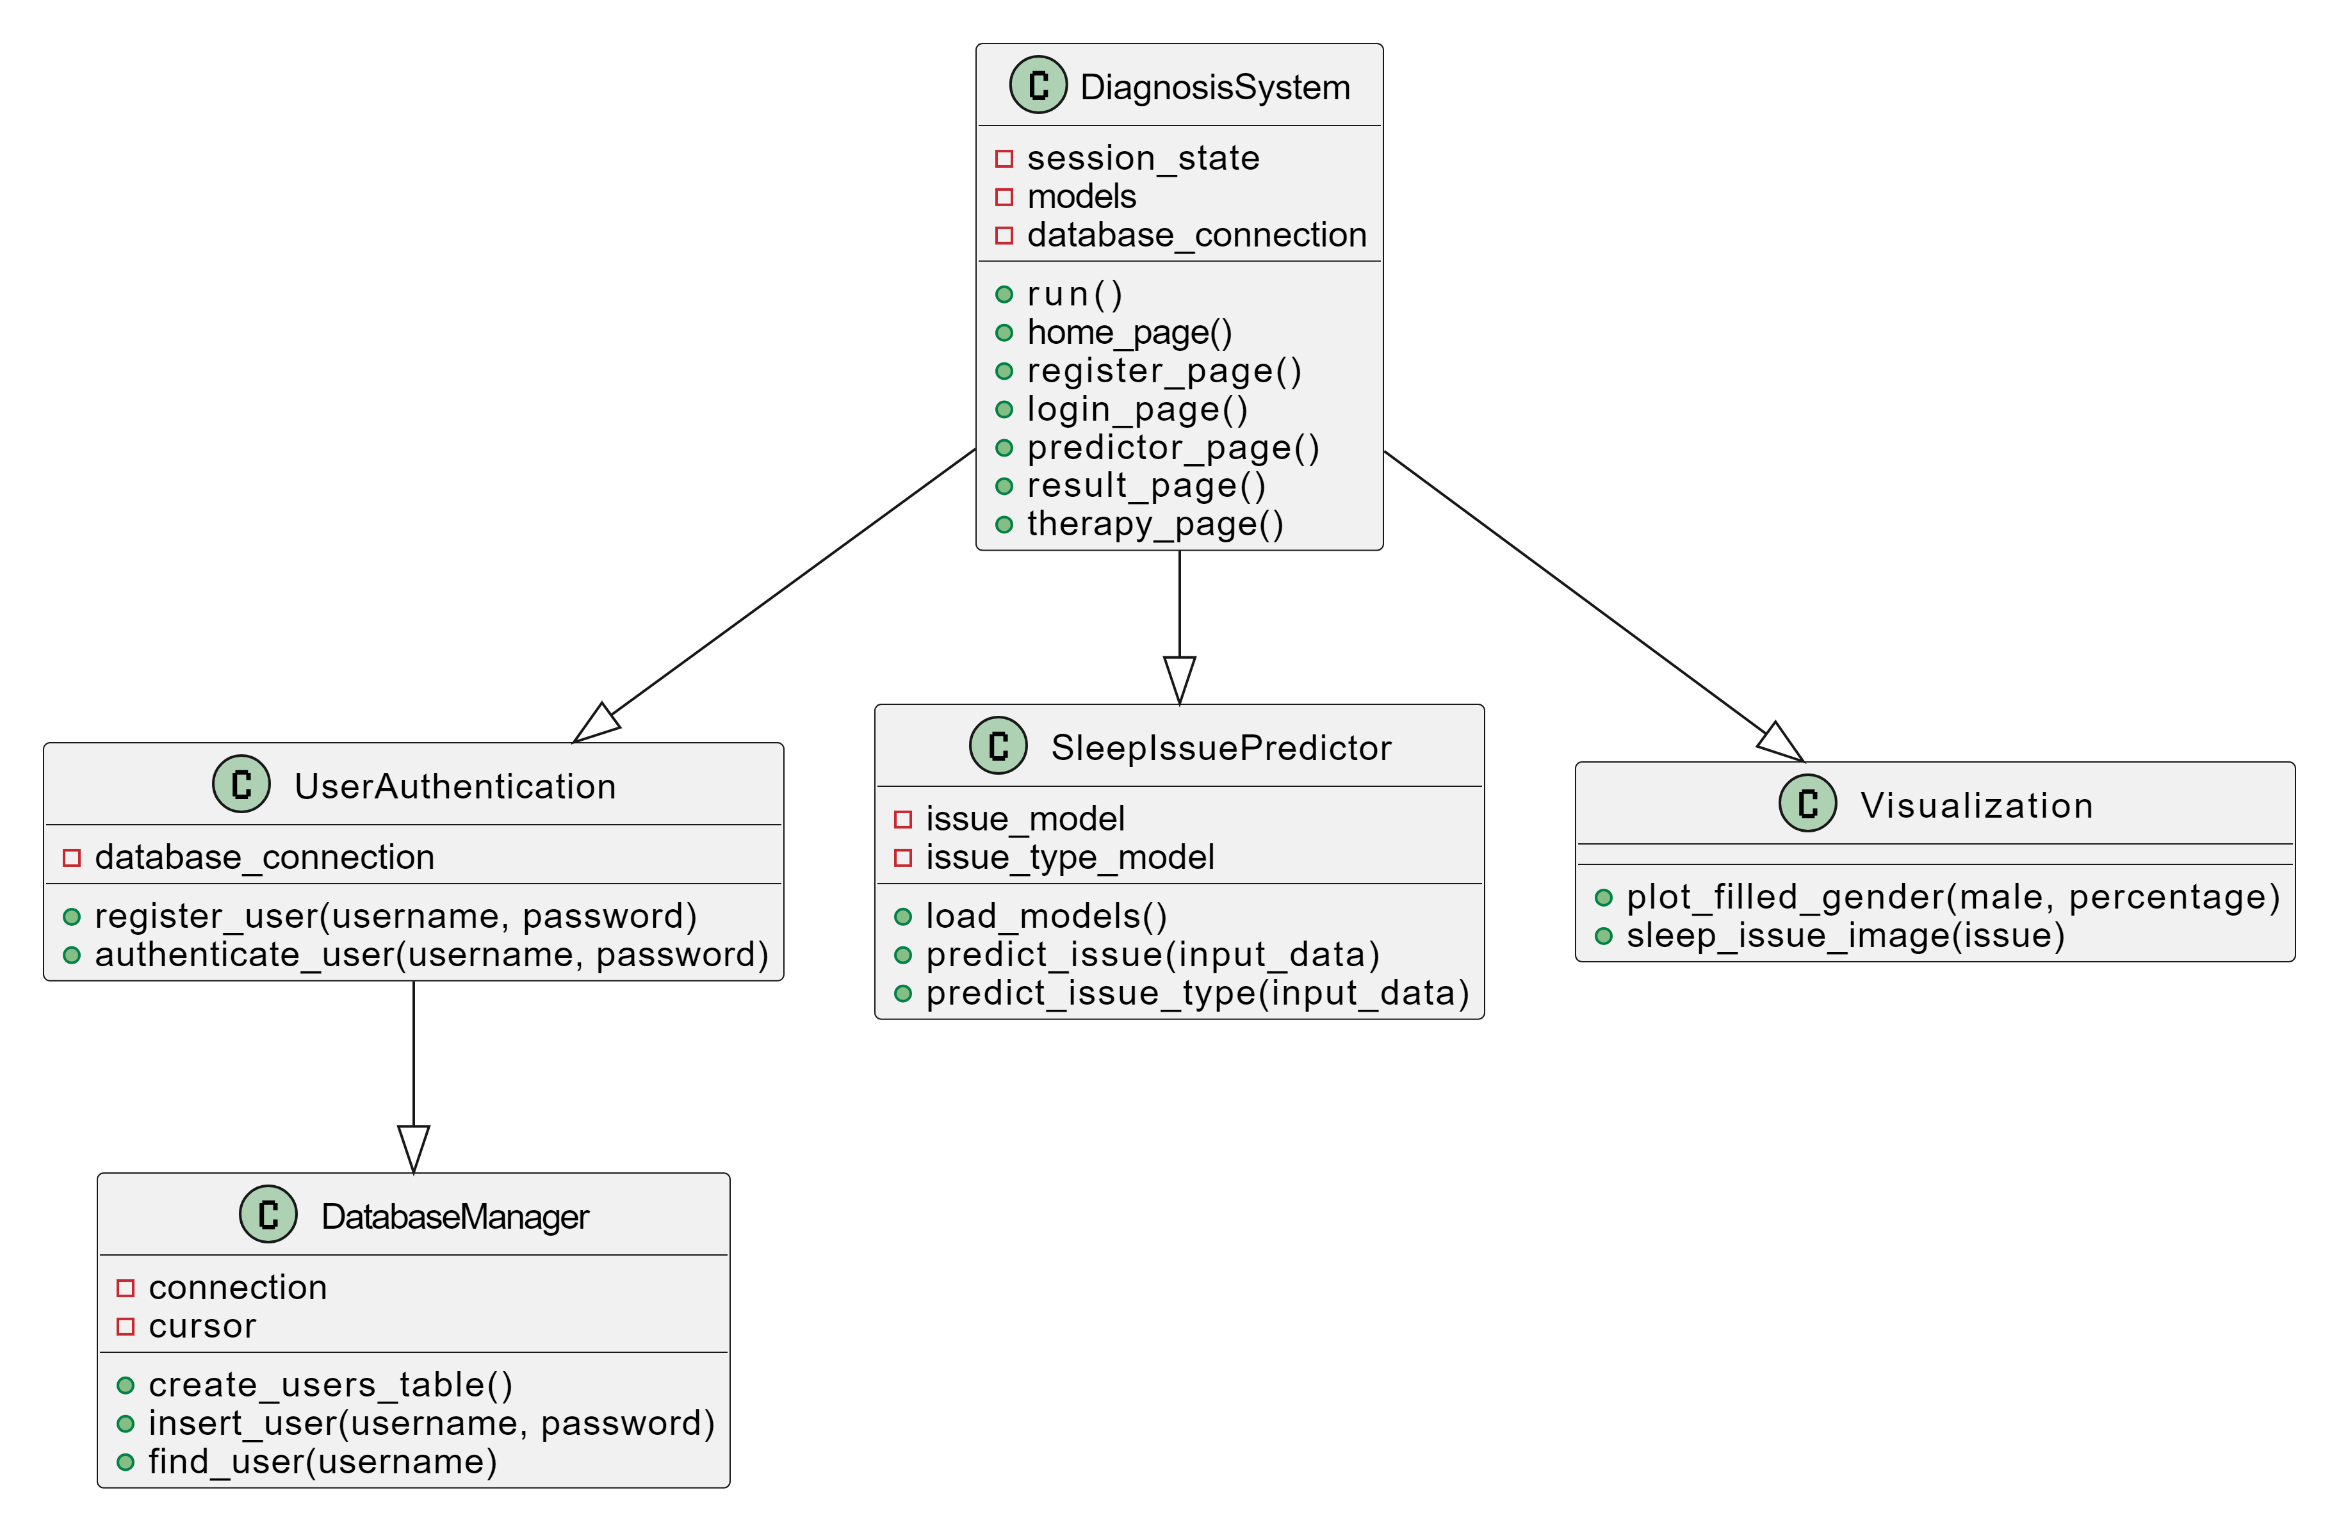
2. Class Diagram

Slide 20
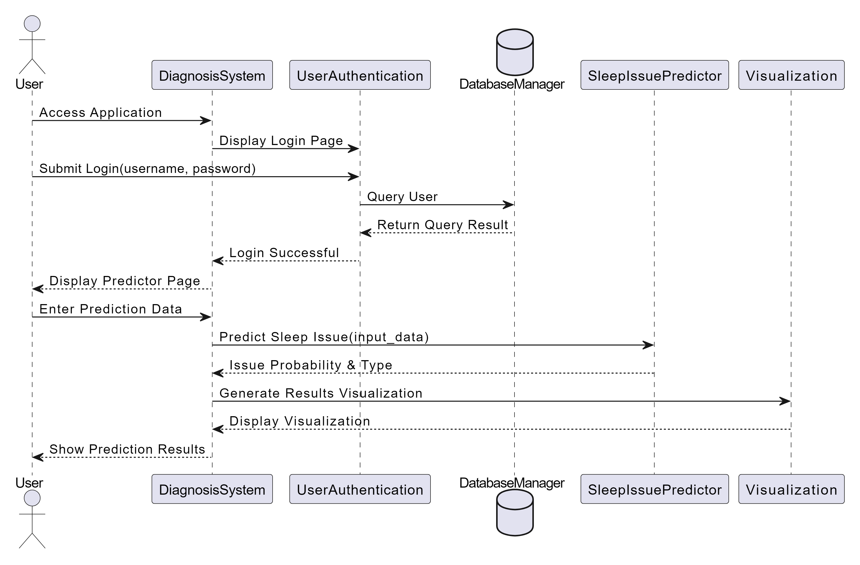
3. Sequence Diagram

Slide 21
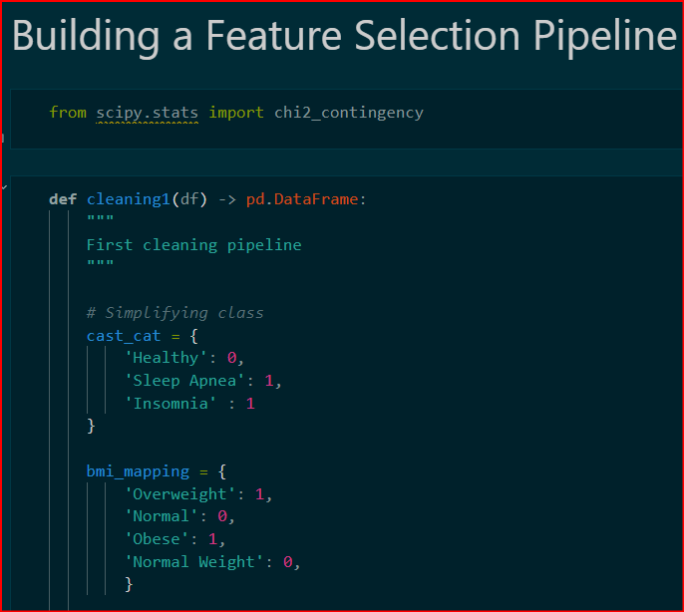
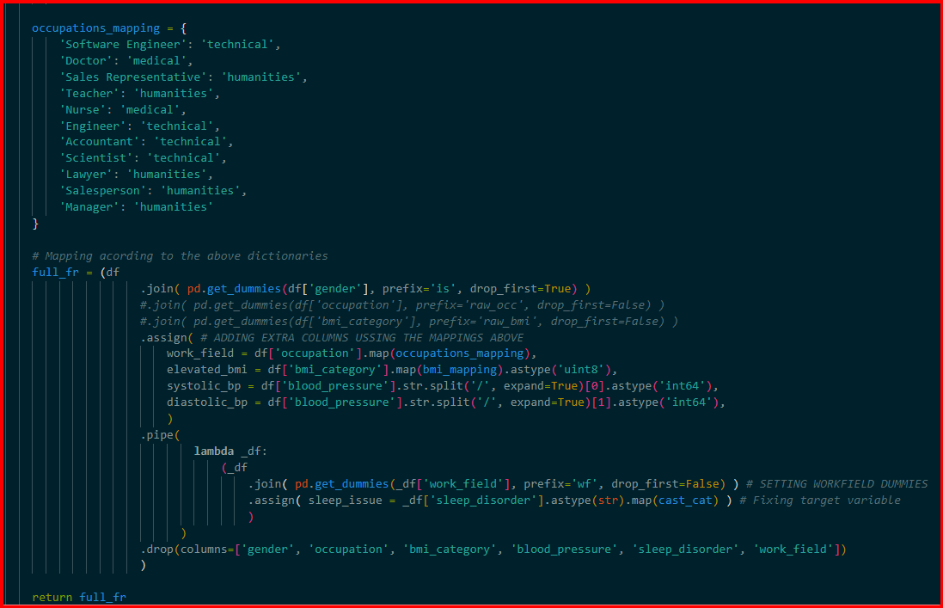
Implementation-Exploratory Data Analysis

Slide 22
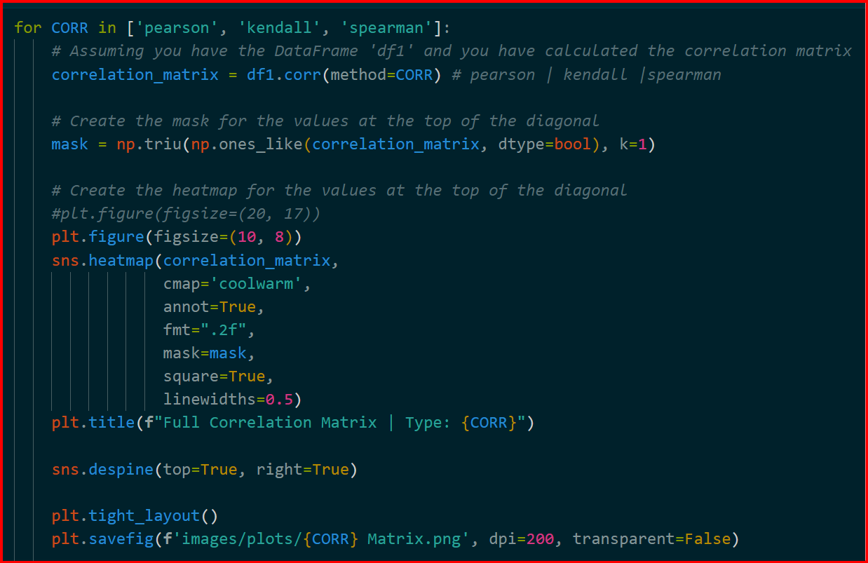

Slide 23
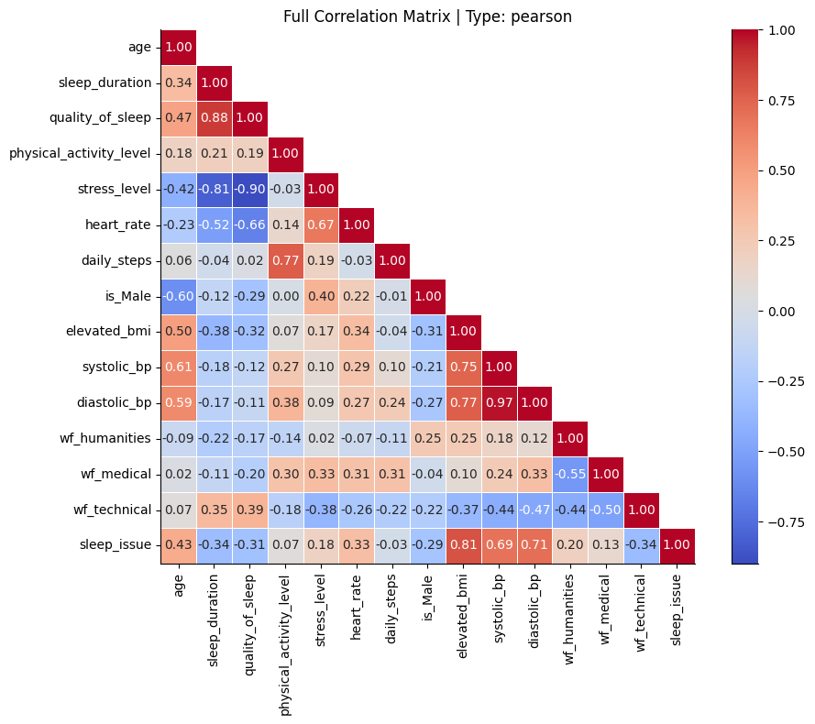
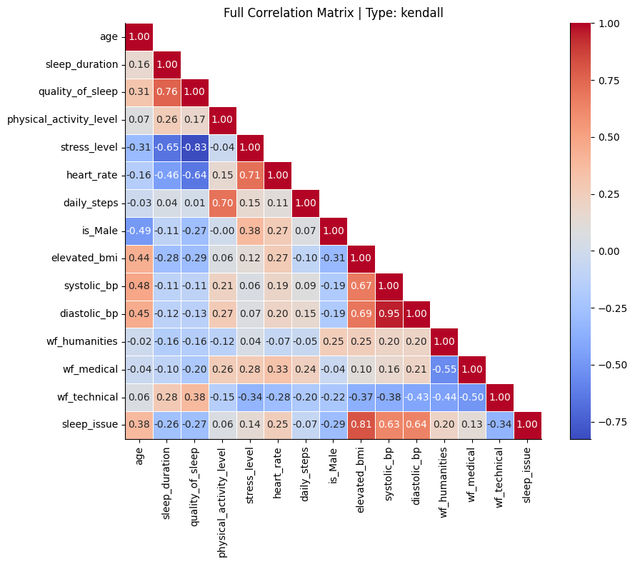

Slide 24
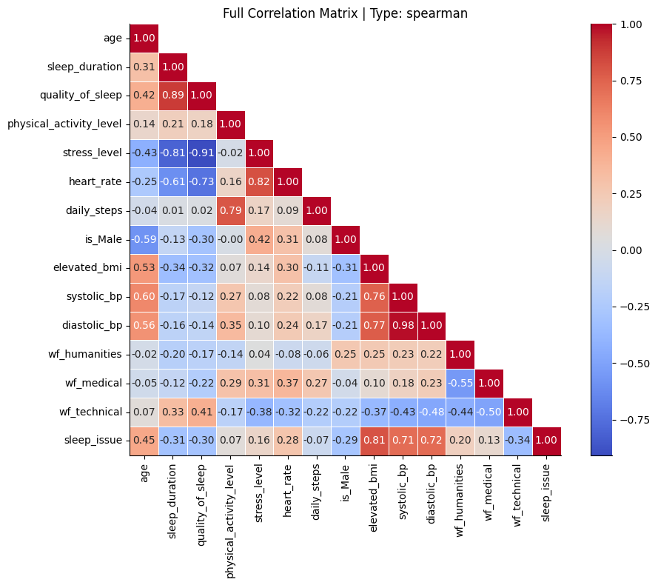
We find several columns correlated between eachother and information that could be redundant.
Such is the case of stress_level and sleep duration.
Source lacks a description on the nature of the stress_level column, is also not possible to derive a conclusion from it because is a column that contains integer values that range from 3 to 8. Because of this ambiguity keeping it into the pipeline won't be useful when generalizing to another population.
Being sleep_duration an easier variable for an hypothetical user to use and to avoid colinearity effects with sleep_duration, let's add stress_level to the list of columns to leave out.

Slide 25
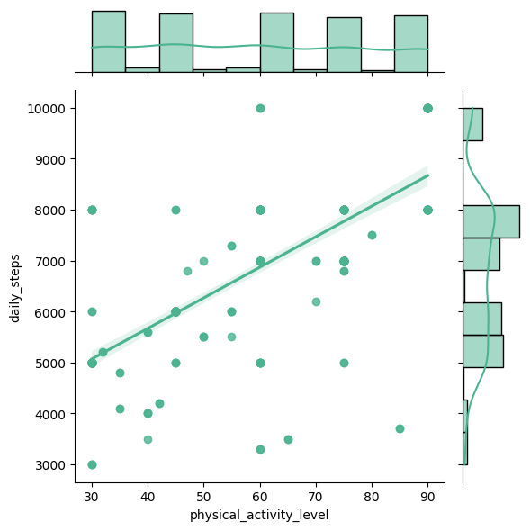
On the other hand, some correlations require further consideration, for example, "Physical Activity" and "Daily steps" are highly correlated. Their histograms look like this.
We can see how Physical Activity histogram is a range that contains unexplained gaps and peaks, one can especulate that it can be more linked to subjective factors and generalizing this without context from the data source can make difficult to interpret and use in an algorithm for predictions.
But Daily Steps does not shows a better picture either, there isn't a high correlation with the target.
Let's keep Daily Steps conditionally, because in practical terms is a value that the user can input and the algorithm use as a physical activity baseline, therefore, let's do another test called Phi Coefficient for Daily steps to assess the relevance with the target.

Slide 26
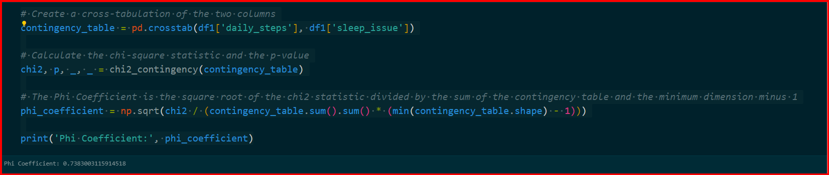
The Phi Coefficient value of approximately 0.738 indicates a strong association between the two variables in your dataset, suggesting that there's a significant relationship between daily_steps and sleep_issue.

Slide 27
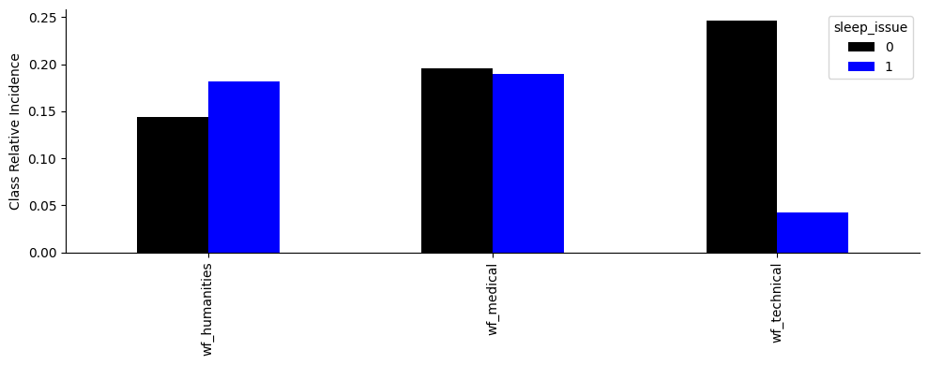
Regarding the work-fields, by the correlation matrix the technical field wf_technicall is a better predictor than its two other counterparts. By keeping out any other fields, is possible reduce complexity for the user and in the training.
This way of categorizing helps in creating a distinction with the target column:

Slide 28
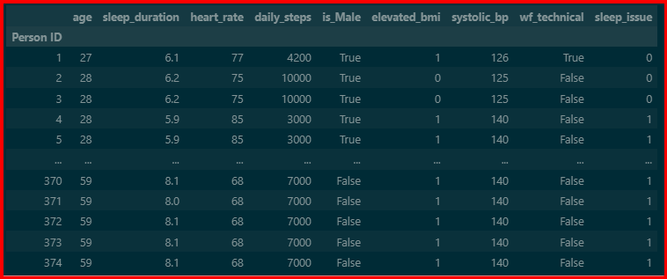
With the table above we can start the process of training and assessing a machine learning algorithm for predicting sleep_issue.

Slide 29
Let's recall. Systolic blood pressure refers to the amount of pressure experienced by the arteries while the heart is beating. Diastolic blood pressure refers to the amount of pressure in the arteries while the heart is resting in between heartbeats.
In all the correlation tests, we can se how these two columns correlate between each other and with the target. To avoid collinearity let's keep only one of these two, but the correlation coefficient changes slightly in all cases, so choosing one of the other based on the assessments we've conducted is indifferent. Someone, perhaps with medical knowledge or with another assessment test, can expand the selection criteria. For now, based on the correlation between the two and the fact that Systolic is always slightly more correlated with the target, this is the column we decide to keep.

Slide 30
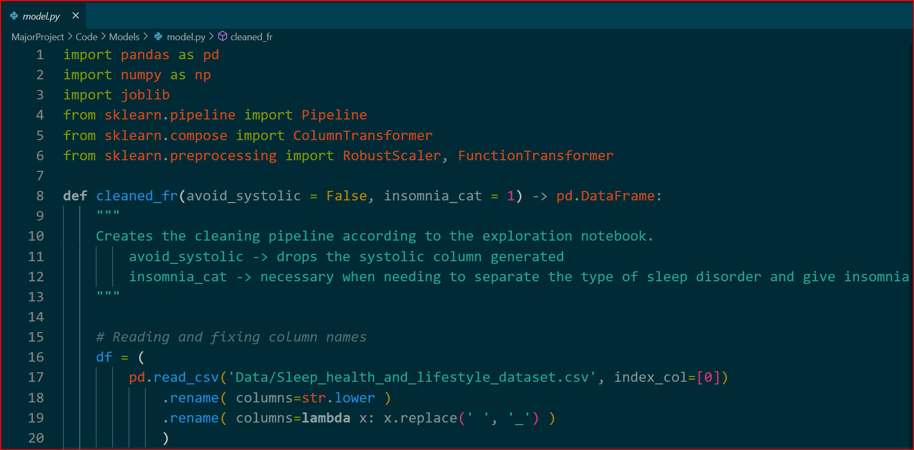
Implementation-Modeling

Slide 31
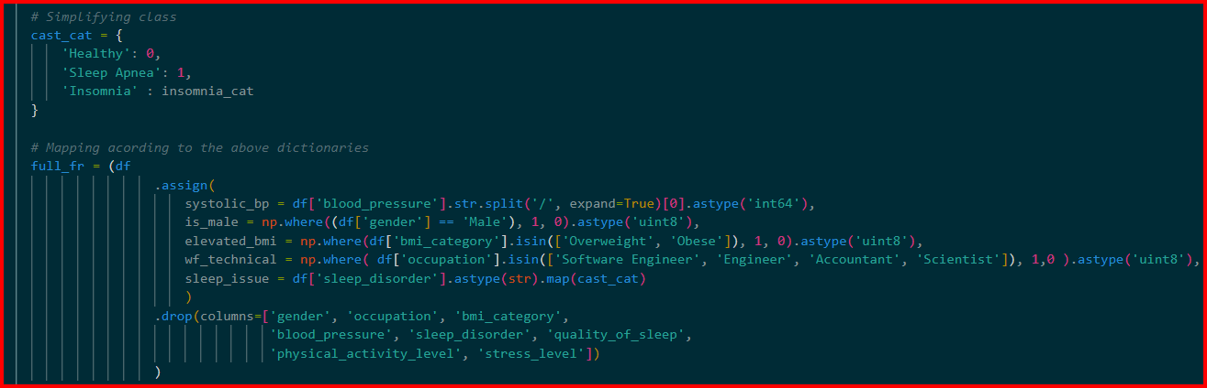

Slide 32
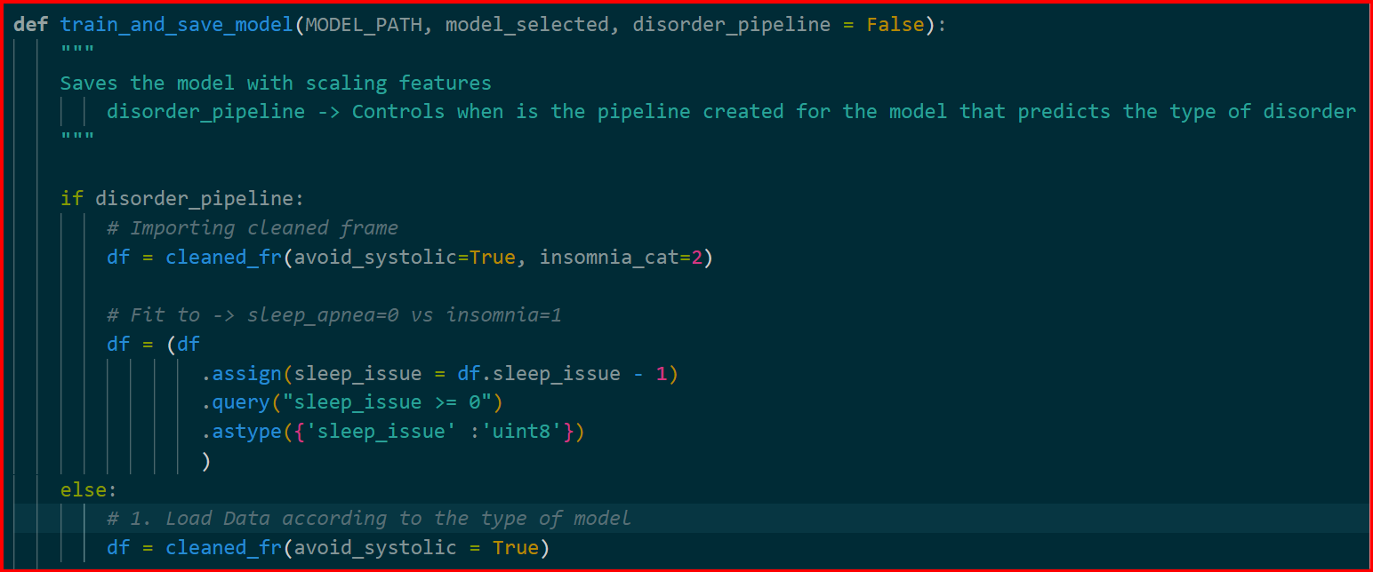

Slide 33
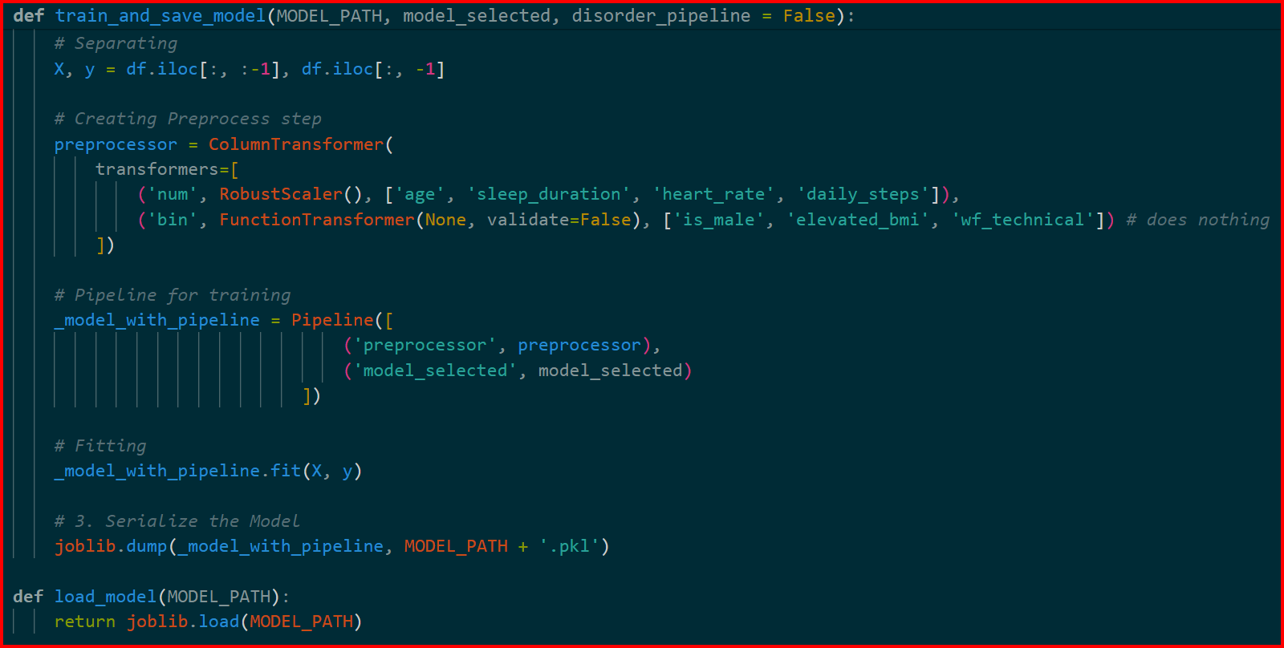

Slide 34
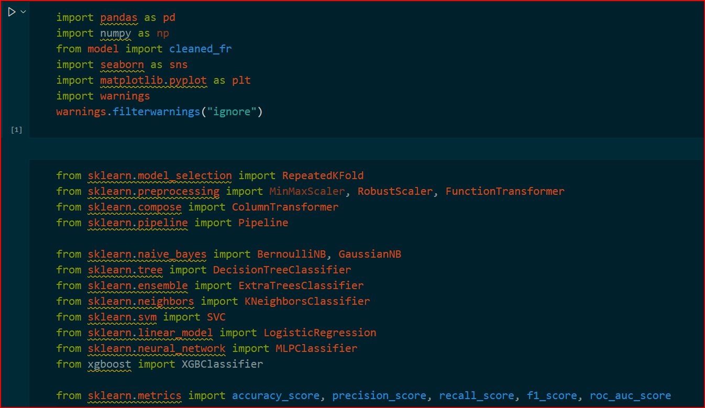
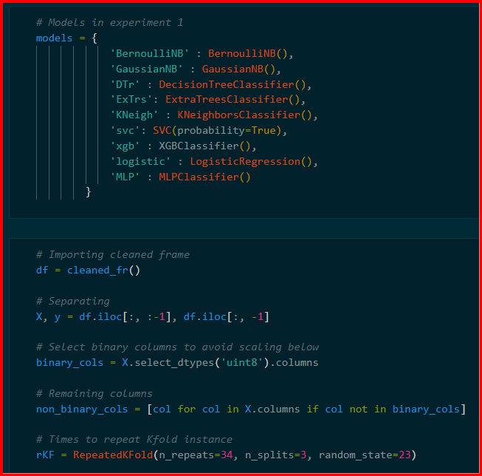

Slide 35
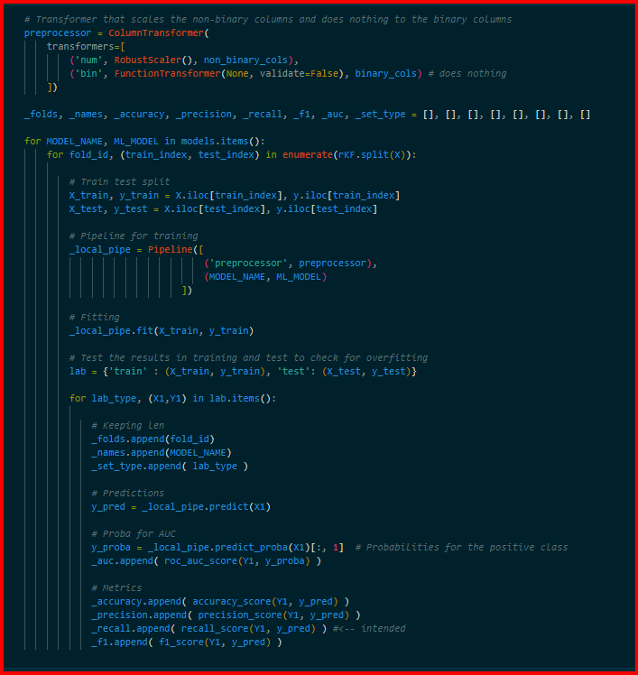

Slide 36
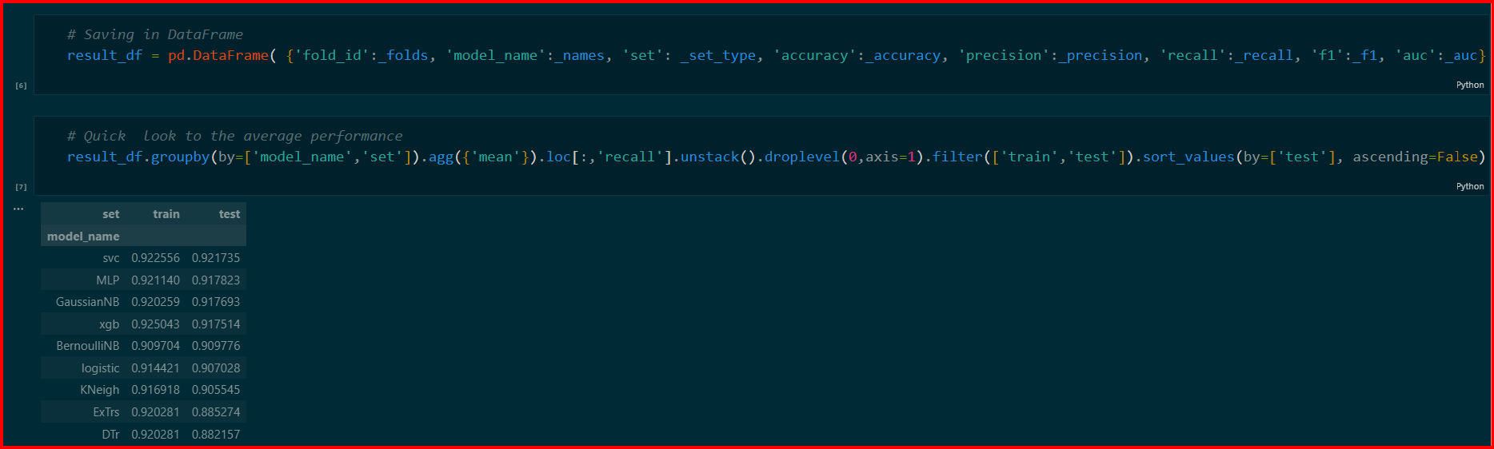
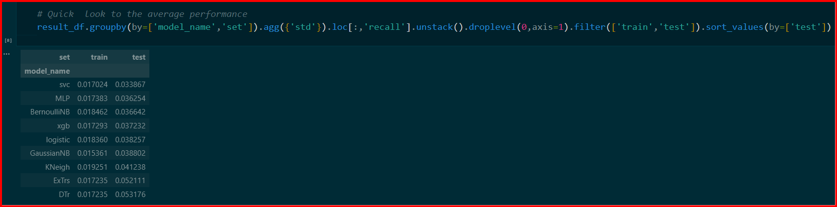

Slide 37
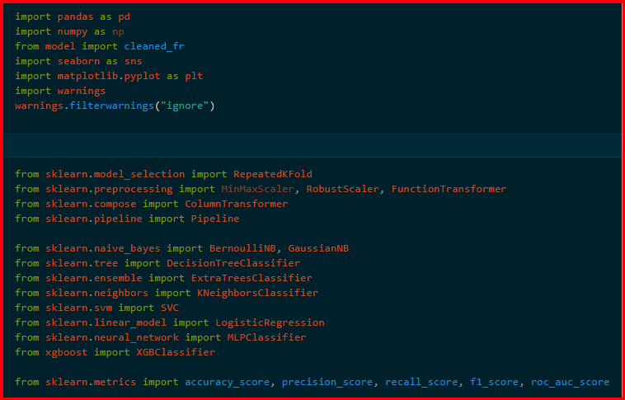

Slide 38
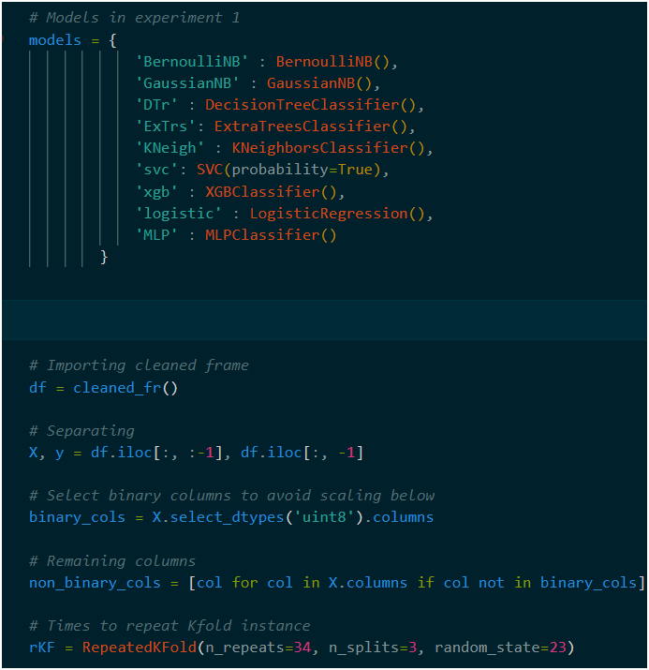

Slide 39
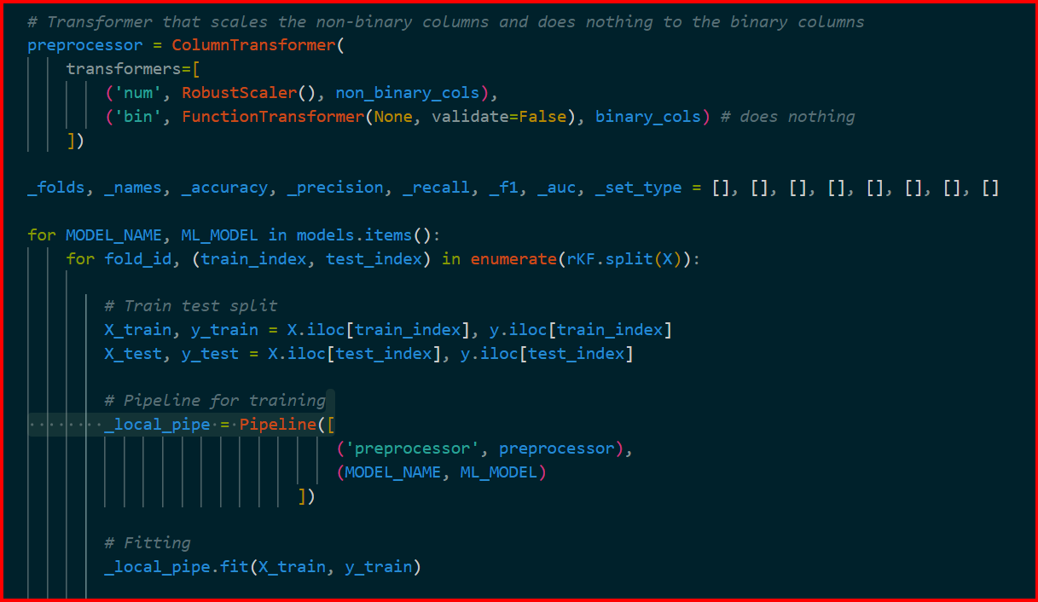

Slide 40
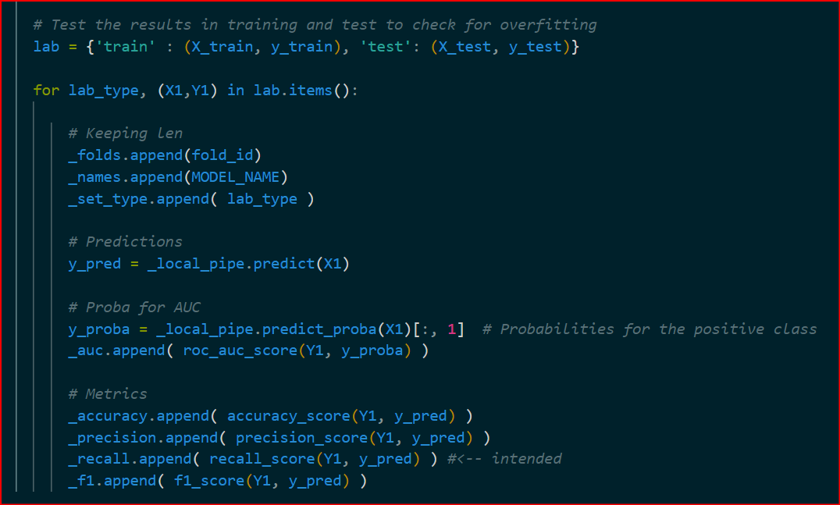

Slide 41
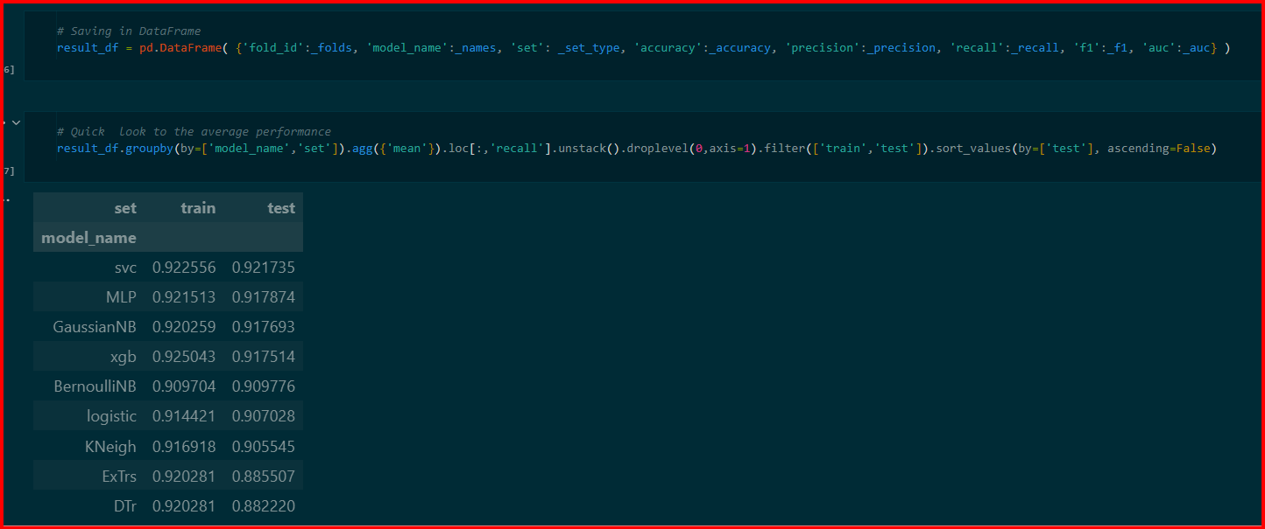

Slide 42
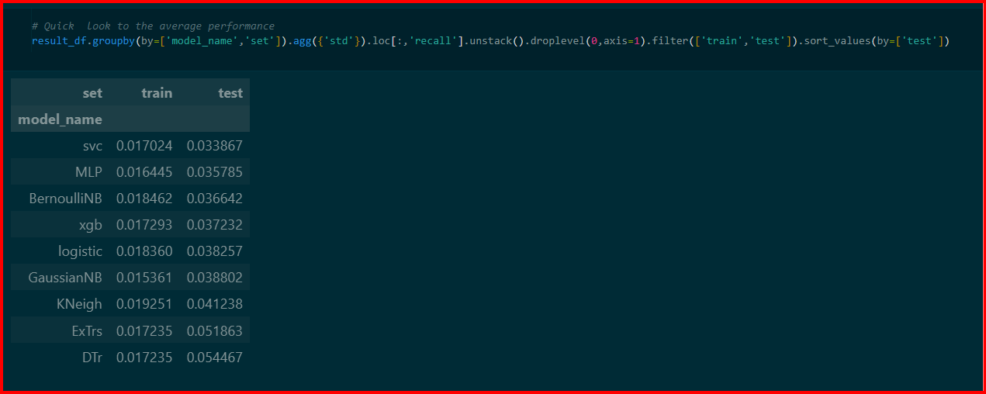

Slide 43
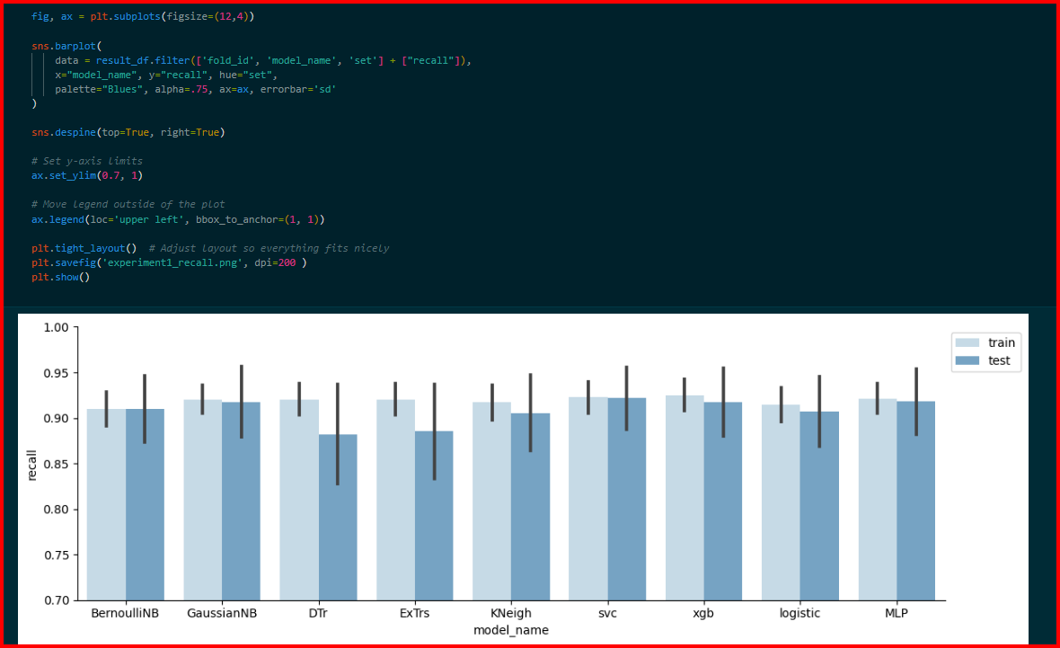

Slide 44
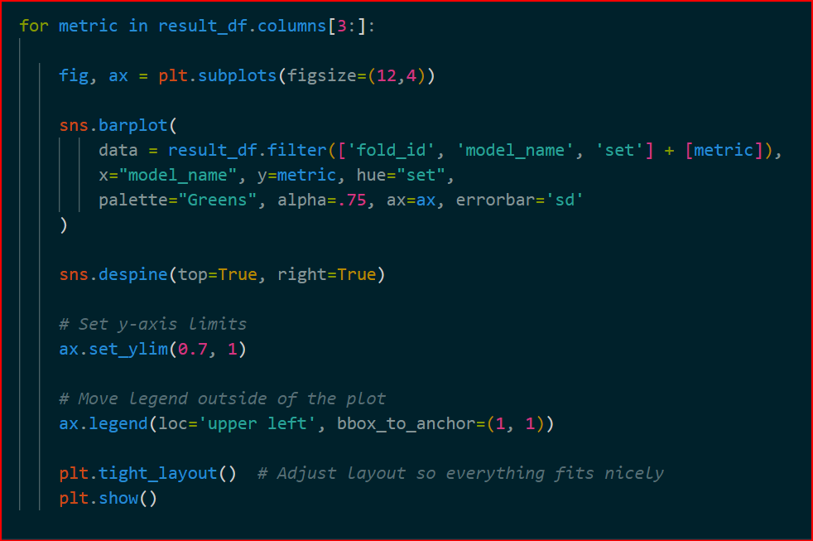

Slide 45
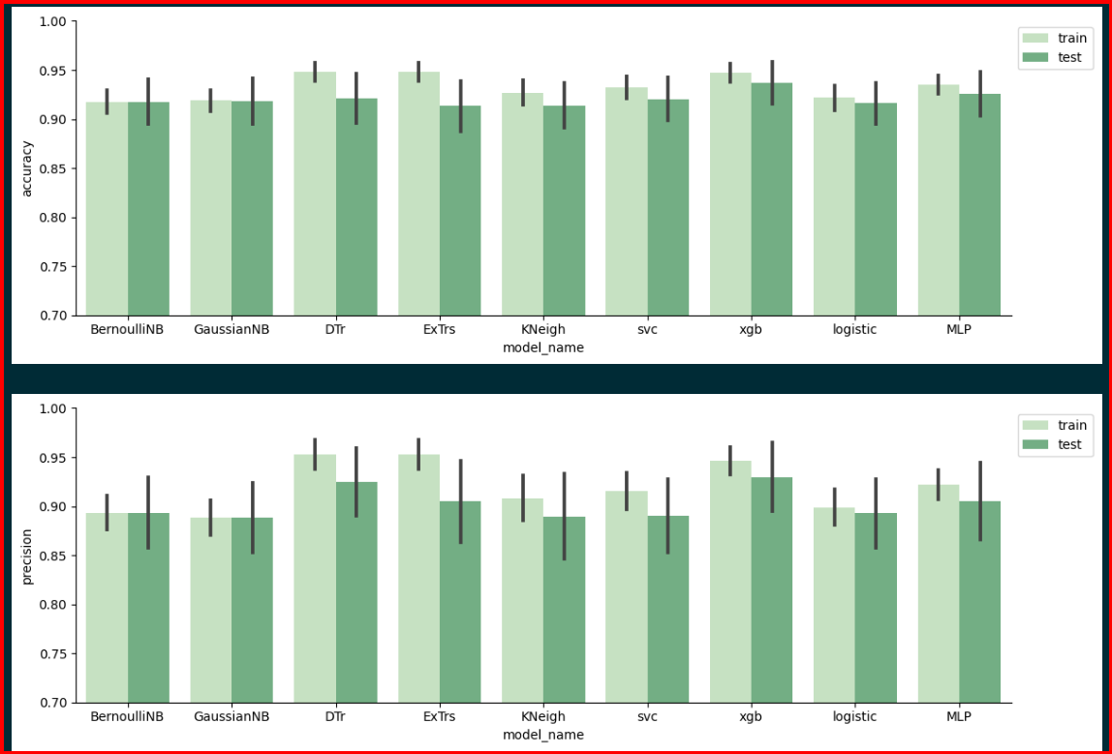

Slide 46
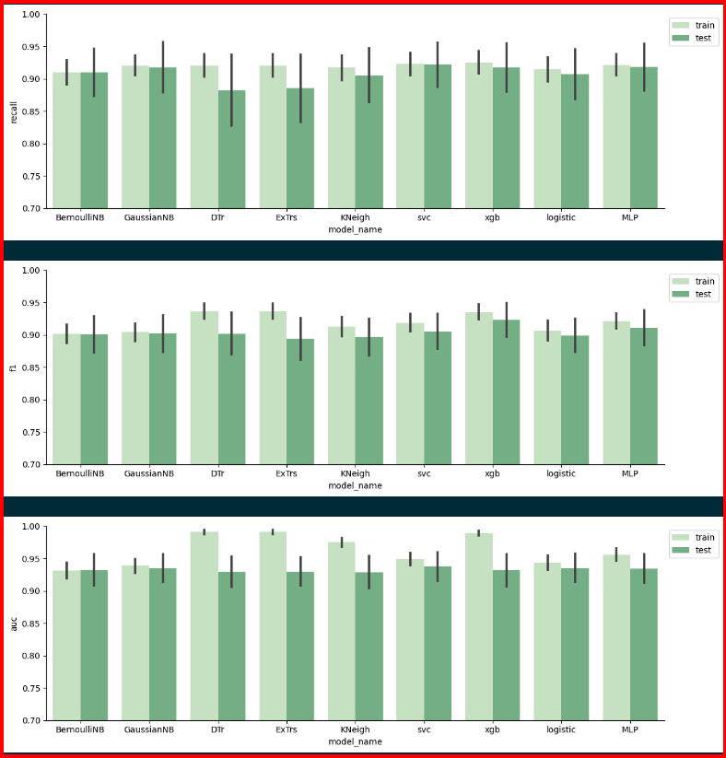

Slide 47
Based on results for recall, which measures the rate of values correctly predicted positive and the real positive, we designate for further exploration and/or hyperparameter fine-tunning the models:
GaussianNB:(no fine-tunning required)
MLP : parameter tuning using GridSearchCV.
SVC: With the highest average recall and the lowest std. We could extract more value from it.
To find parameters that improve the performance of the default parametrization.

Slide 48
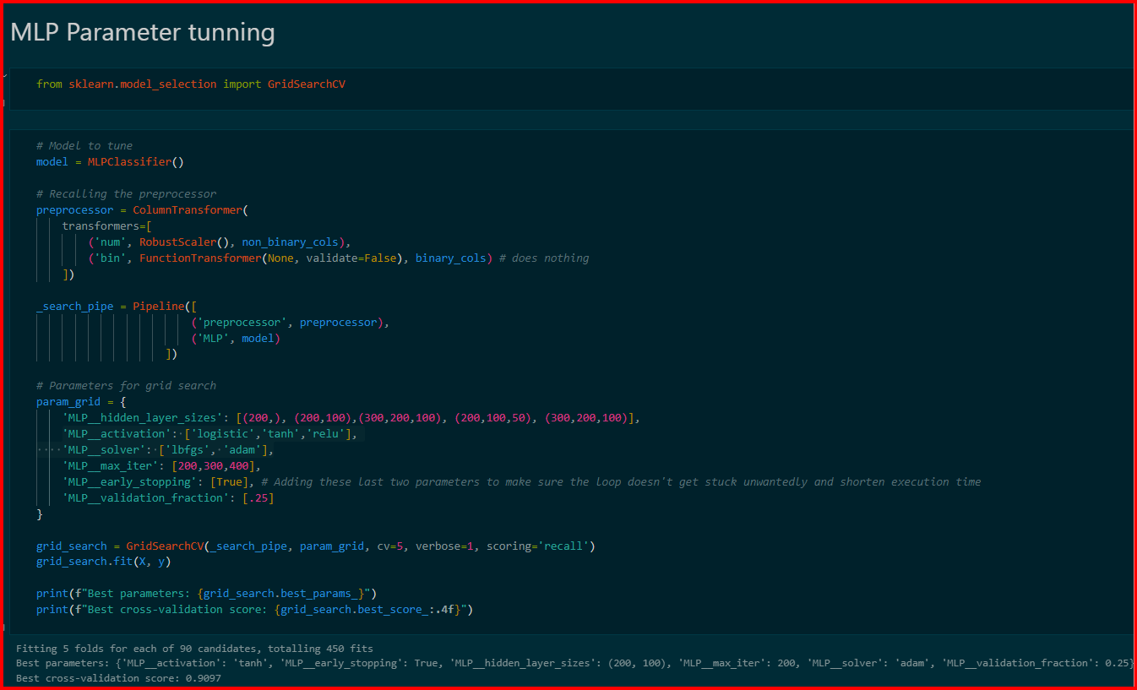

Slide 49
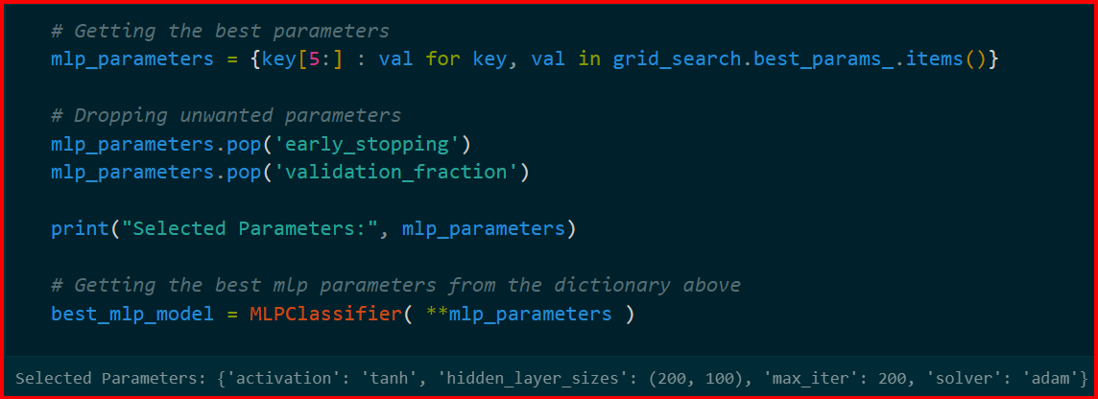

Slide 50
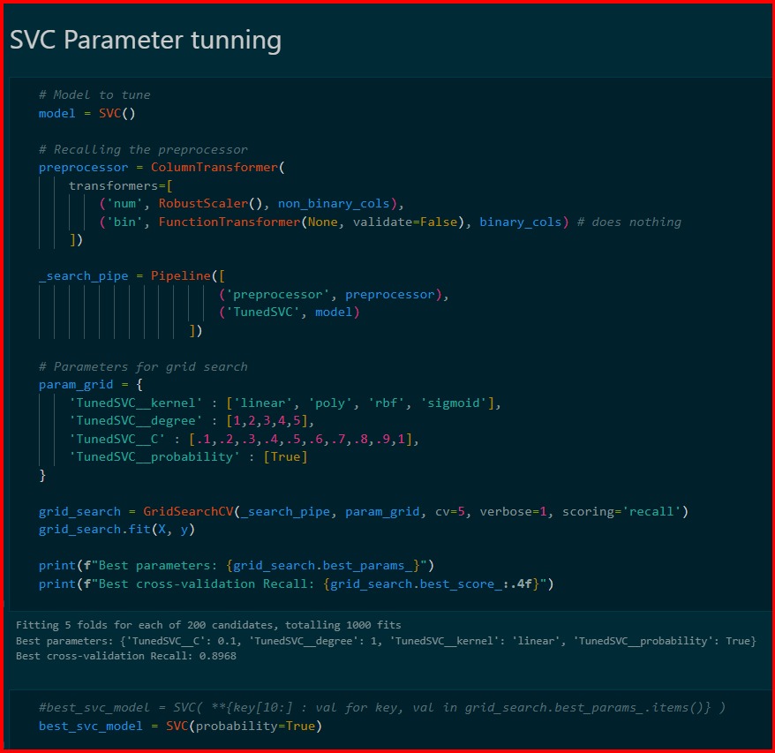

Slide 51
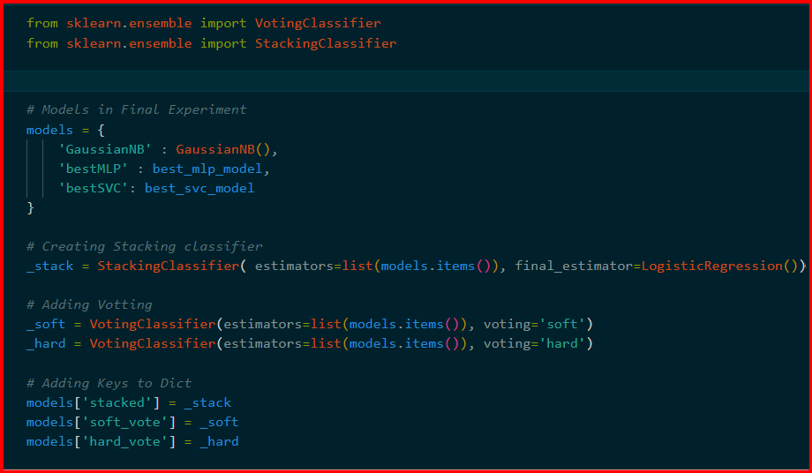

Slide 52
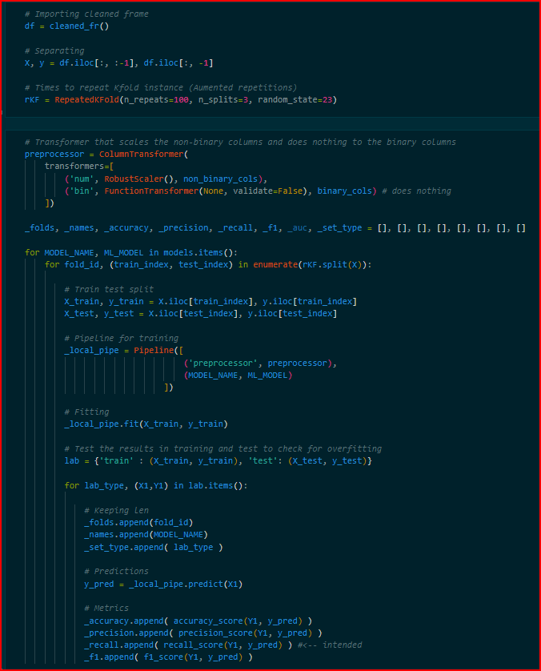

Slide 53
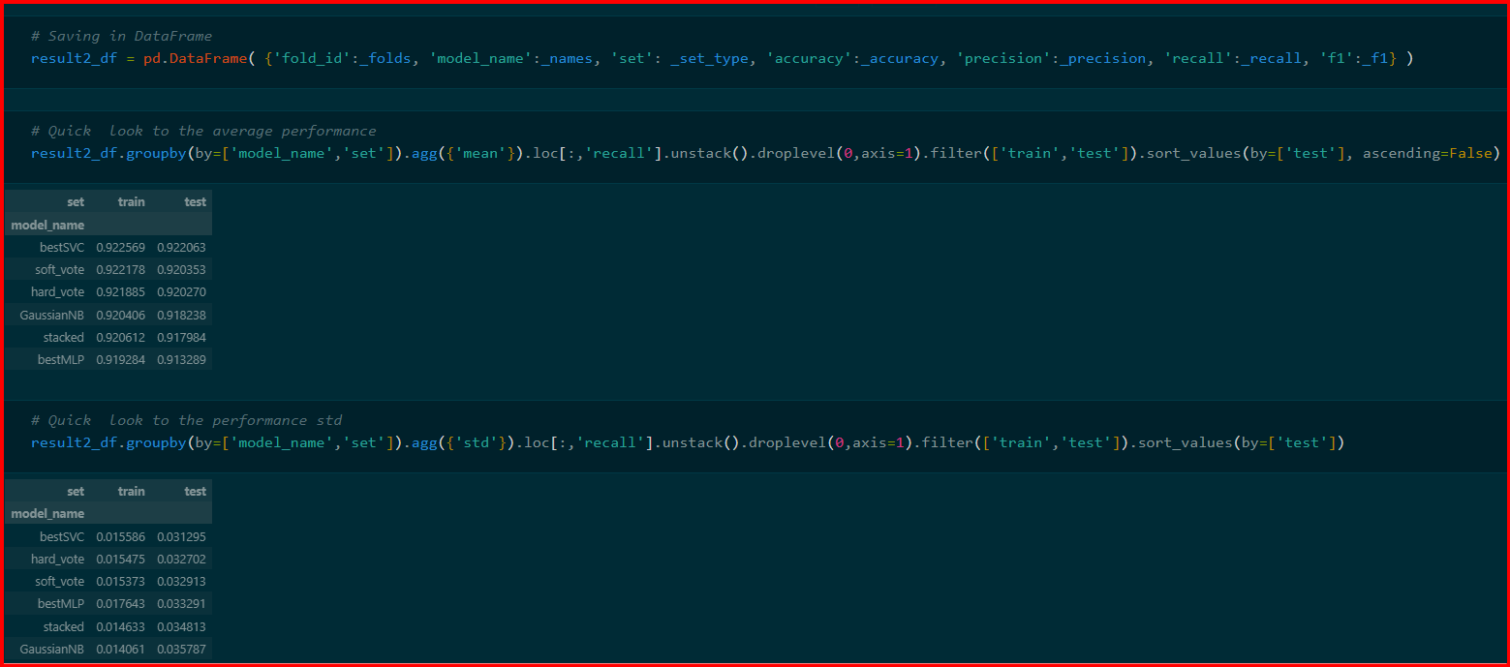

Slide 54
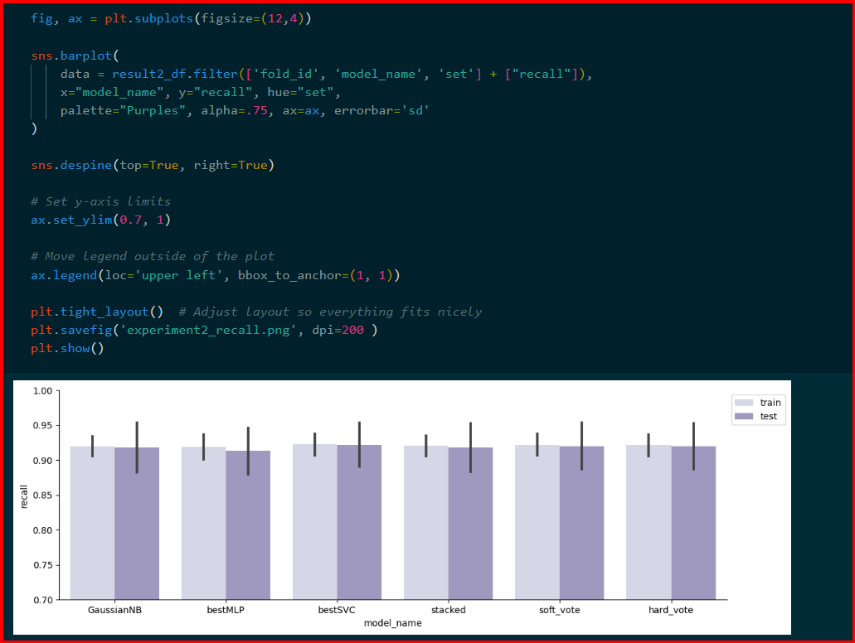

Slide 55


Slide 56
REFERENCES
[1] Ha, Seokmin, et al. "Predicting the Risk of Sleep Disorders Using a Machine Learning–Based Simple Questionnaire: Development and Validation Study." Journal of medical Internet resaearch 25 (2023): e46520.
[2] Han, H., Oh, J. Application of various machine learning techniques to predict obstructive sleep apnea syndrome severity. Sci Rep 13, 6379 (2023). https://doi.org/10.1038/s41598-023-33170-7
[3] Han, H., Oh, J. Application of various machine learning techniques to predict obstructive sleep apnea syndrome severity. Sci Rep 13, 6379 (2023). https://doi.org/10.1038/s41598-023-33170-7
[4] Wongsirichot, T. and Hanskunatai, A., 2017. A classification of sleep disorders with optimal features using machine learning techniques. Journal of Health Research, 31(3), pp.209-217.
[5] Korpinen, L., and H. Frey. "Sleep Expert—an intelligent medical decision support system for sleep disorders." Medical Informatics 18.2 (1993): 163-170.

Slide 57
[6] Xu, Shuting, et al. "A review of automated sleep disorder detection." Computers in Biology and Medicine 150 (2022): 106100.
[7] Ankitha, V., et al. "Literature review on sleep APNEA analysis by machine learning algorithms using ECG signals." Journal of Physics: Conference Series. Vol. 1937. No. 1. IOP Publishing, 2021.
[8] Kemidi, M., Marur, D. R., & Chantigari, V. K. R. (2023). Detection and Classification of Obstructive Sleep Apnea Disorders: A Comparative Analysis of Various Deep Machine Learning Classifiers. Revue d'Intelligence Artificielle, 37(1).
[9] Cheng, Y. H., Lech, M., & Wilkinson, R. H. (2023). Simultaneous Sleep Stage and Sleep Disorder Detection from Multimodal Sensors Using Deep Learning. Sensors, 23(7), 3468.
[10] Javeed, Ashir, et al. "Predictive power of XGBoost_BiLSTM model:a machine-learning approach for accurate sleep apnea detection using electronic health data." International Journal of Computational Intelligence Systems 16.1 (2023): 188.

Slide 58
[11] Learning, M. U. S. M. (2020). Obstructive sleep apnea: a prediction model using supervised machine learning method. The Importance of Health Informatics in Public Health during a Pandemic, 272, 387.
[12] Jain, Gunjit. Sleep Apnea detection using Deep Learning Methodologies. Diss. Dublin, National College of Ireland, 2022.
[13] Karimi Moridani M, Hajiali A. Automated sleep stage detection based on recurrence quantification analysis using machine learning. Journal of applied research on industrial engineering. 2022 Oct 1;9(4):409-26.
[14] Arslan, R. S. (2023). Sleep disorder and apnea events detection framework with high performance using two-tier learning model design. PeerJ Computer Science, 9, e1554.
[15] Ramachandran, Anita, and Anupama Karuppiah. "A survey on recent advances in machine learning based sleep apnea detection systems." Healthcare. Vol. 9. No. 7. MDPI, 2021.

